Slide 1
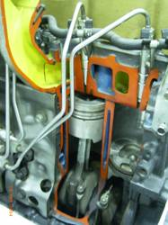
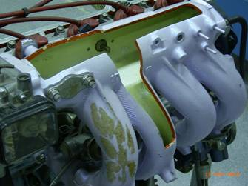
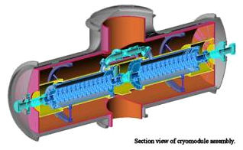
Chapter 8
Section Views

Slide 2
TOPICS
Introduction
Terminology & common practices
Kind of sections
Dimensioning

Slide 3

Introduction

Slide 4
GRAPHICS COMMUNICATION
WITH ENGINEERING DRAWING
Object
Orthographic Projection
Dimensioning
Working
drawing
Orthographic
projection
(convention)
No
Clear ?
Section Views
Yes
Section views
convention
Finish

Slide 5
PURPOSES OF
SECTION VIEWS
Clarify the views by
reducing or eliminating the hidden lines.
revealing the cross sectional’s shape.
Facilitate the dimensioning.
Let See the example

Slide 6
EXAMPLE : Advantage of using a section view.

Slide 7
Terminology and common practices

Slide 8
CUTTING PLANE
Cutting plane is a plane that imaginarily cuts
the object to reveal the internal features.
Cutting
plane
Cutting plane line
Section lines

Slide 9
CUTTING PLANE LINE
Cutting plane line is an edge view of the cutting plane.
Indicate the path
of cutting plane.

Slide 10
CUTTING PLANE LINESTYLES
Thick line
ANSI
standard
Viewing
direction
Thick line
Viewing
direction
JIS & ISO
standard
Thin line
This course
Viewing
direction

Slide 11
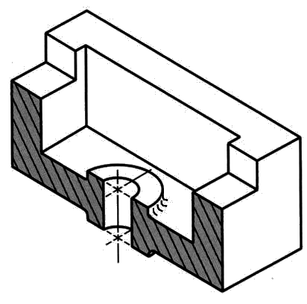
SECTION LINING
Section lines or cross-hatch lines are used to
indicate the surfaces that are cut by the cutting
plane.
Section
lines
Drawn with 4H pencil.

Slide 12
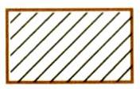
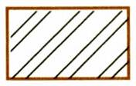
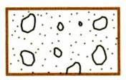
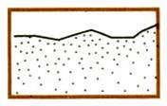
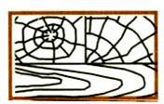
SECTION LINES SYMBOLS
The section lines are different for each of material’s type.
For practical purpose, the cast iron symbol is used most often for any materials.
Cast iron,
Malleable iron
Steel
Concrete
Sand
Wood

Slide 13
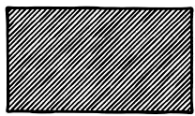
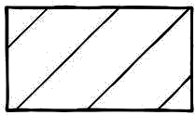
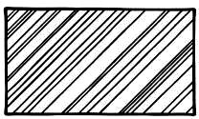
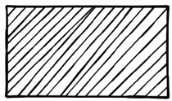
SECTION LINING PRACTICE
The spaces between lines may vary from 1.5 mm
for small sections to 3 mm for large sections.
COMMON MISTAKE

Slide 14
SECTION LINING PRACTICE
It should not be drawn parallel or perpendicular to contour of the view.
COMMON MISTAKE

Slide 15
Kinds of Sections

Slide 16
KIND OF SECTIONS
1. Full section
2. Offset section
3. Half section
4. Broken-out section
5. Revolved section (aligned section)
6. Removed section (detailed section)

Slide 17
FULL SECTION VIEW
The view is made by passing the straight cutting plane completely through the part.

Slide 18
OFFSET SECTION VIEW
The view is made by passing the bended cutting plane completely through the part.
Do not show the edge views
of the cutting plane.

Slide 19
TREATMENT OF HIDDEN LINES
Hidden lines are normally omitted from section
views.

Slide 20
HALF SECTION VIEW
The view is made by passing the cutting plane halfway through an object and remove a quarter of it.

Slide 21
HALF SECTION VIEW
A center line is used to separate the sectioned half from the unsectioned half of the view.
Hidden line is omitted in unsection half of the view.

Slide 22

BROKEN-OUT SECTION VIEW
The view is made by passing the cutting plane normal to the viewing direction and removing the portion of an object in front of it.

Slide 23
BROKEN-OUT SECTION VIEW
A break line is used to separate the sectioned portion from the unsectioned portion of the view.
Break line is a thin continuous line (4H) and is drawn freehand.
There is no cutting plane line.

Slide 24
EXAMPLE : Comparison among several section techniques

Slide 25
REVOLVED SECTION VIEW
Revolved sections show cross-sectional
features of a part.
No need for additional orthographic views.
This section is especially helpful when a
cross-section varies.

Slide 26
REVOLVED SECTION VIEW
Basic concept

Slide 27
REVOLVED SECTION VIEW
Basic concept

Slide 28
REVOLVED SECTION VIEW
Steps in construction
Given
Edge view of
cross-section
Step 1
a. Assign position of cutting plane.
b. Draw axis of rotation in front view.

Slide 29
REVOLVED SECTION VIEW
Steps in construction
Given
Step 2
a. Transfer the depth dimension to
the front view.

Slide 30
REVOLVED SECTION VIEW
Steps in construction
Given
Step 3
a. Draw the revolved section.
b. Add section lines.

Slide 31
REVOLVED SECTION VIEW
Steps in construction
Given
FINAL PICTURE

Slide 32
REVOLVED SECTION VIEW
Placement of revolved section
1. Superimposed to orthographic view.
2. Break from orthographic view.
Break
Superimposed

Slide 33
6. Removed section
REMOVED SECTION VIEW
Removed section is revolved section.
Section view is shown outside the view.
Used where space does not enough for revolved section
Can be located elsewhere on a drawing with properly labeled

Slide 34
REMOVED SECTION VIEW
Example : Revolved vs. removed sections.
Revolved section
Removed section

Slide 35
REMOVED SECTION VIEW
Example : Situation that removed section is preferred.
Poor
Preferred
Too messy !!

Slide 36
REMOVED SECTION VIEW
Example : Multiple removed section views
A
B
B
A
SECTION B – B
SECTION A – A

Slide 37
Dimensioning in Section View

Slide 38
In most cases, dimensioning of the section views
follows the typical rules of dimensioning.
POOR
GOOD

Slide 39
DIMENSIONING
POOR
GOOD
10
10
φ 50
φ 50

Slide 40
DIMENSIONING
For a half-section view,
use dimension line with
only one arrowhead that
points to the position inside
the sectioned portion.
φ 50

